Slide 1
AI Parking Assistant
Stage 4 — LangGraph Orchestration
All four stages unified into one graph-based multi-agent pipeline

Slide 2
What's new in Stage 4?
The first three stages worked. Stage 4 makes them work together — one graph, one pipeline.
Feature
St.1
St.2
St.3
St.4
Parking Q&A via RAG
✓
✓
✓
✓
Reservation collection
✓
✓
✓
✓
Admin approval flow
✗
✓
✓
✓
MCP FastAPI server
✗
✗
✓
✓
LangGraph orchestration
✗
✗
✗
✓
Unified pipeline
✗
✗
✗
✓
Full integration testing
✗
✗
✗
✓

Slide 3
The LangGraph workflow
LangGraph defines nodes and edges — the graph decides what runs next based on the current state.
START
↓
user_interaction
RAG Q&A + reservation collection
↓ booking?
NO → END
admin_approval
HITL agent notifies admin
↓ approved?
NO → notify user → END
mcp_processing
MCP server writes to file
↓
END

Slide 4
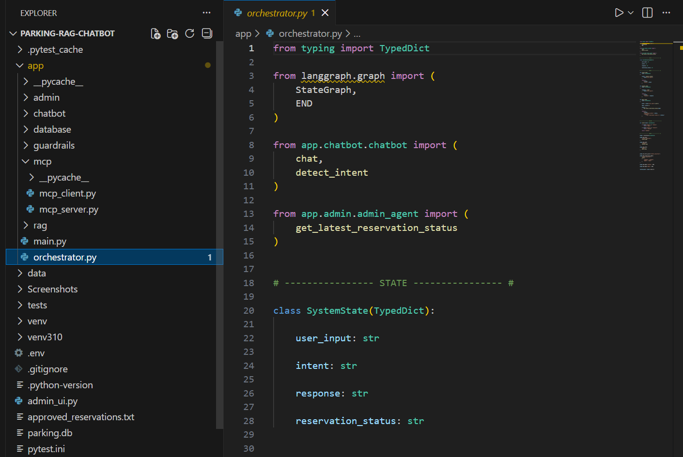
The orchestrator
orchestrator.py defines the SystemState and imports from all three agent layers.
[screenshot: orchestrator-code.png]
from langgraph.graph import StateGraph, END · SystemState tracks user_input, intent, response, reservation_status

Slide 5
End-to-end flow
1. User sends a message via Streamlit UI
↓
2. LangGraph routes to user_interaction node
Stage 1
↓
3. Booking complete → routed to admin_approval
Stage 2
↓
4. Admin approves via admin panel
Stage 2
↓
5. Routed to mcp_processing node
Stage 3
↓
6. MCP server writes to approved_reservations.txt
Stage 3
↓
7. User notified — reservation confirmed ✓

Slide 6
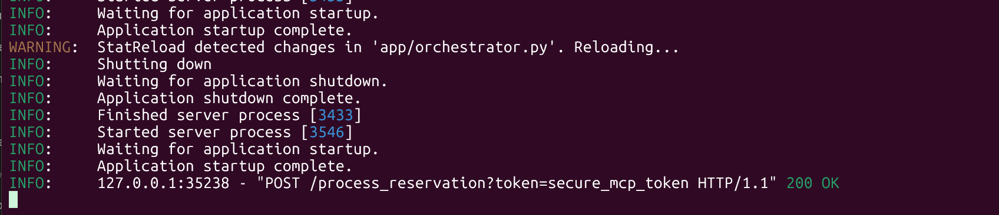
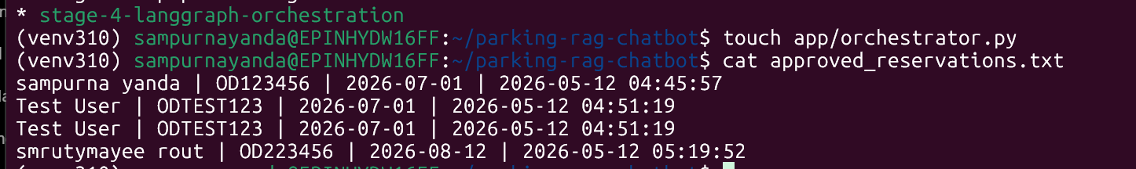
Pipeline working end-to-end
[screenshot: orchestration-flow.png]
✅ POST /process_reservation → 200 OK
approved_reservations.txt
File format: Name | Car Number | Reservation Period | Approval Time
sampurna yanda | OD123456 | 2026-07-01 | 2026-05-12 04:45:57

Slide 7
Testing
At least 2 tests per module. Run all with "pytest -v"
test_chatbot.py
test_info_query · test_guardrail · test_status_query
RAG responses, guardrail blocking, status queries.
test_mcp.py
test_mcp_processing · test_mcp_response_message
MCP server processing and response format.
test_orchestrator.py
NEW
test_orchestrator_rag_flow · test_orchestrator_status_flow
LangGraph routing and full pipeline flow.
test_reservation.py
test_reservation_start · test_reservation_flow · test_reservation_datetime
Booking conversation and DB write operations.
[screenshot: pytest-results.png] → 10 passed ✓

Slide 8
Project complete 🎉
All four stages built, tested, and integrated.
Stage 1 ✓
RAG Chatbot
LangChain · RAG · Guardrails · Streamlit
Stage 2 ✓
Human-in-the-Loop
Admin approval · HITL agent · SQLite
Stage 3 ✓
MCP Microservice
FastAPI · Token auth · File storage
Stage 4 ✓
LangGraph Orchestration
Unified graph · Multi-agent pipeline · Integration tests
github.com/sampurna-yanda/parking-rag-chatbot · branch: stage-4-langgraph-orchestration

